Slide 1
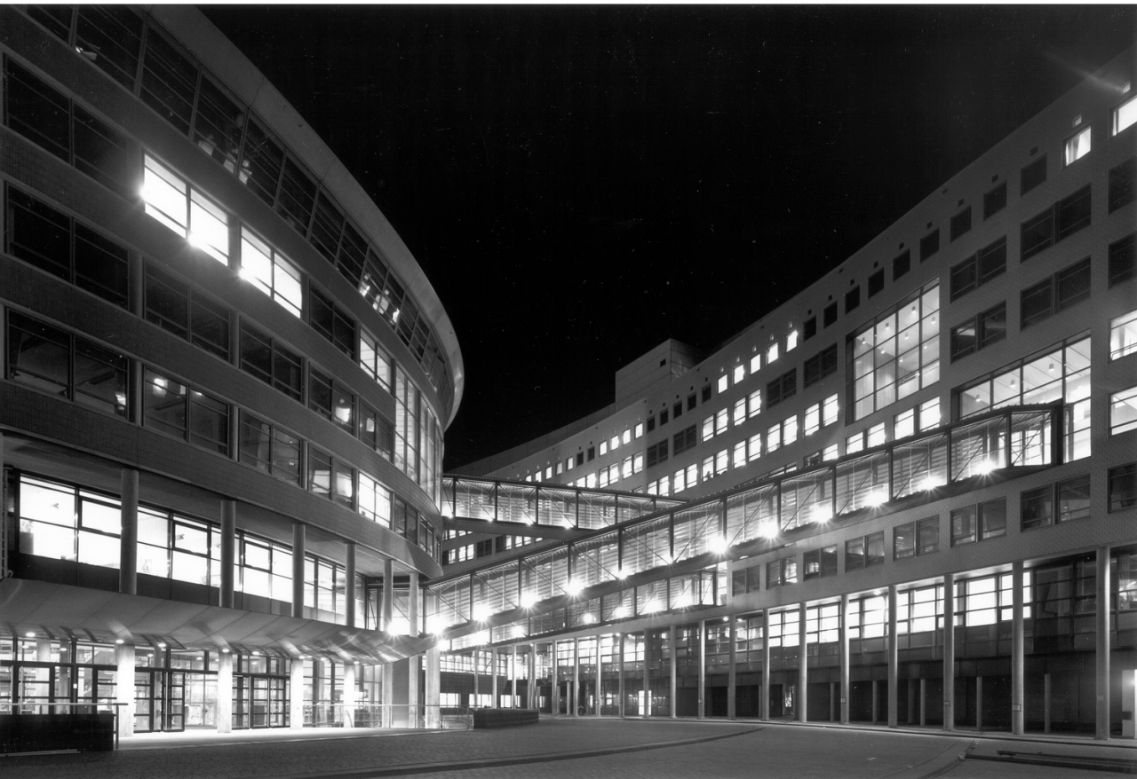


OPSCHALER
Progress Week 2
7-9-2018

Slide 2


Contents
Sprint recap
Practice with test data
Literature
Data imported
Next sprint planning
Data cleaning & visualization
Data analytical process
Long term planning

Slide 3
Introduction
Forecasting energy consumption
Predict the activity of people in their homes

Slide 4
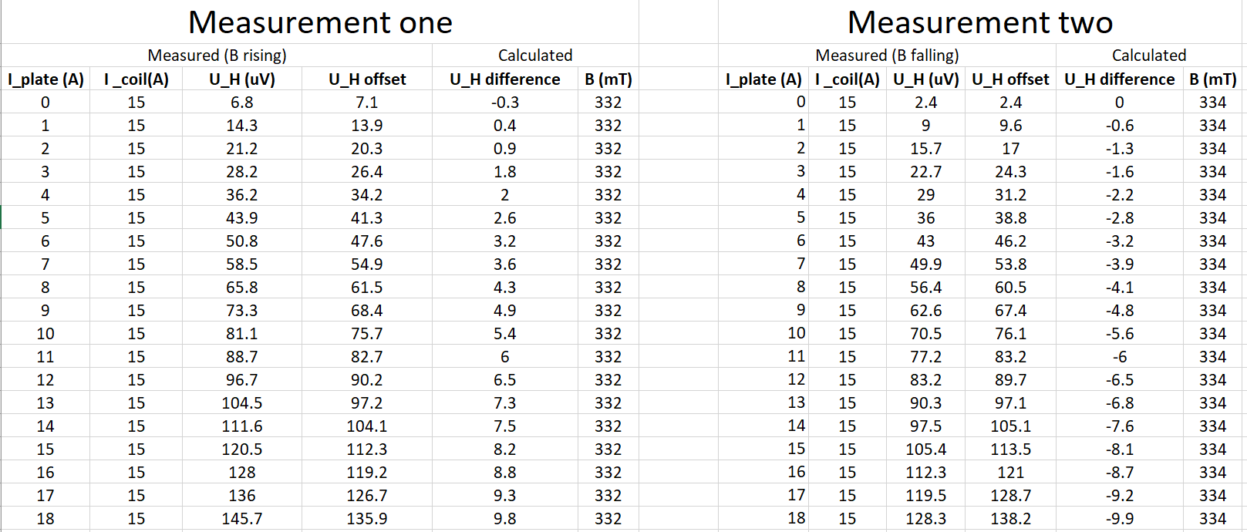
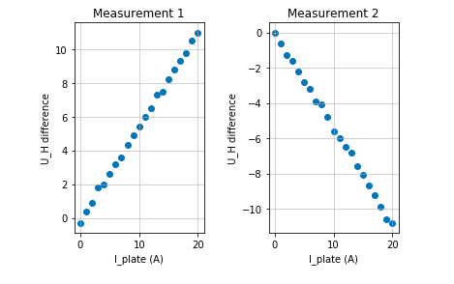
Practice with Test Data

Slide 5



Literature

Slide 6
Imported Data
Sensor + Excel formulier
Smartmeter
Weather

Slide 7
Next sprint planning
7-9-2018

Slide 8



Data Cleaning & Visualization

Slide 9
Exploratory analysis
Exploratory Data Analysis
Single regression
Multiple regression

Slide 10
Long term planning
7-9-2018

Slide 11
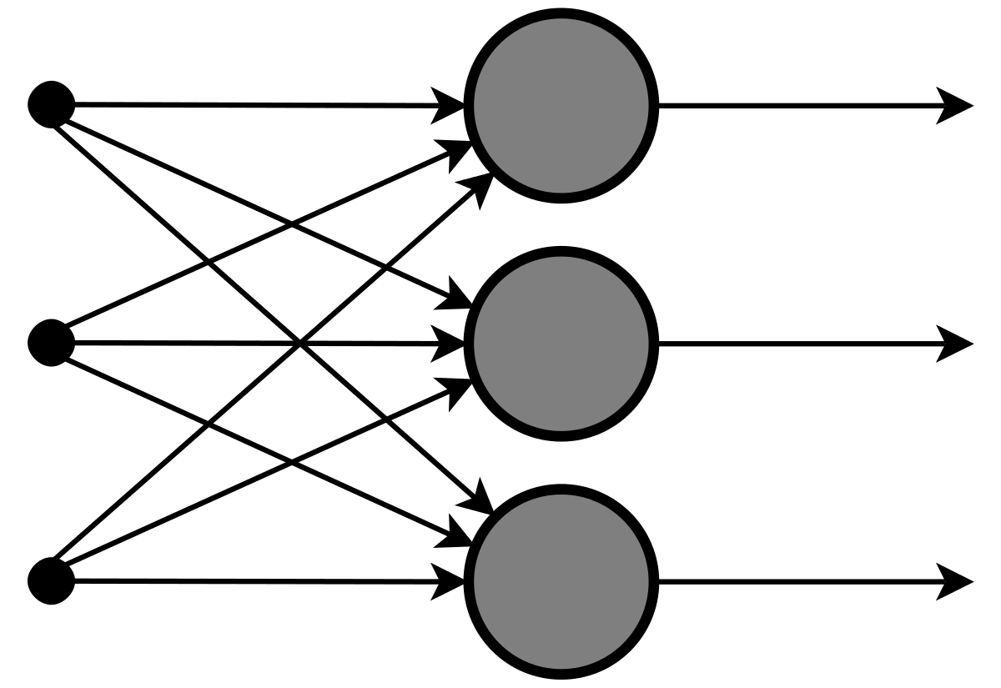
Long term planning
Simple ANN
Top of the line ANN
Neural network

Slide 12
Any questions?
7-9-2018

